Slide 1
Lecture 1: Introduction
BY: Subash Acharya

Slide 2
Very Important
Please be on time for your classes, lateness will not be entertained !!
Attendance will be taken on a daily basis
Class assignments must be submitted on time
Mobile phones should be kept on silent and order should be maintained during class hours
Note that your attendance and class performance will affect your final grade

Slide 3
Agenda
Programming
Python Basics
Python Variables and Data Types
Basic Math Operations

Slide 4
Programming
A programming language is a computer system created to allow humans to precisely express algorithms using a higher level of abstraction without reference to the computer operations and the internal information representation
Programming languages shield users from details of the machine: A single Python statement might map to one, tens, or hundreds
of machine instructions
Basically a program is a set of instructions for the computer to perform/execute

Slide 5
What we will be using ?
We will be using python 3
Can be downloaded and easily installed link for download: www.python.org/downloads
Python is installed on lab systems but if you want you can bring your own laptops to lab classes
We will be using IDLE as our default IDE (Integrated Development Environment)
.

Slide 6
Programming Paradigms
Programming paradigms are ways of structuring and organizing code
There exist many programming paradigms, popular ones are imperative/procedural and object oriented programming (OOP)
.

Slide 7
Procedural Programming
Characterized by sequential sets of linear commands where you write statements for the computer to execute
• Code can be grouped into procedures and functions
• Functions and procedures are a series of instructions that are performed on a given parameter or parameters. Functions return a value while procedures don’t.
• Basic concepts are: ▪ Sequence (execution moves forward one statement at a time)
▪ Selection (if statements) ▪ Iteration (loops)
.

Slide 8
Object Oriented Programming
Based on the concept of classes whose instances are called objects
Classes store data in form of attributes
Each class has its own methods which perform some operations
Useful in modelling real world entities
For example, think of a person class, a person has attributes such as name, address, height, weight, etc. A person can talk, walk and interact with another person, so those are the methods of the class
.

Slide 9
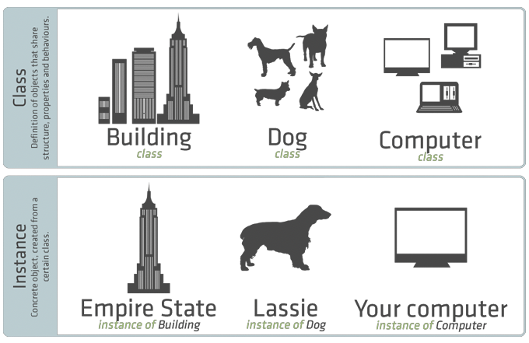
Object Oriented Programming
.

Slide 10
Compiled VS Interpreted Language
In compiled languages, source code is converted/compiled into machine code first and the program is run
Whereas in the case of interpreted languages, each line of code is translated into machine code and executed one at a time by the interpreter
When a python program is run, the python interpreter reads and executes each line of code one by one
.

Slide 11
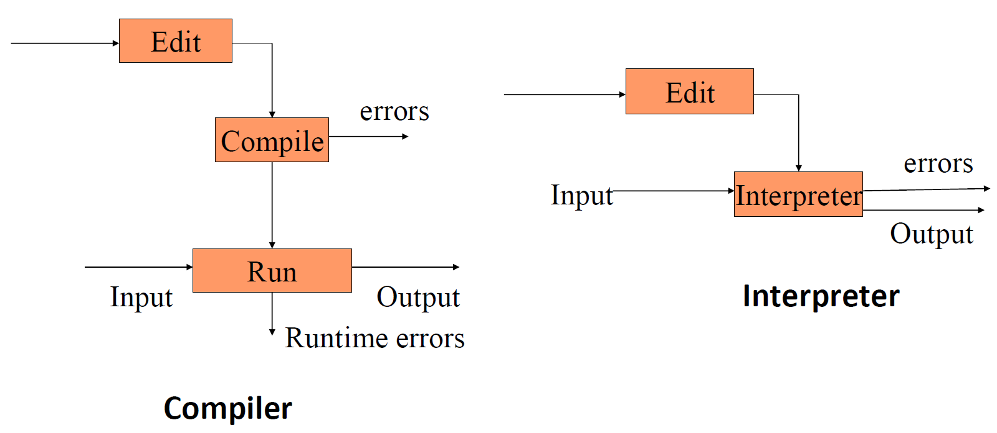
Compiled VS Interpreted Language
.

Slide 12
Data Types
int – represent integers, eg. 5
float – represent real numbers, eg. 2.12
bool – represent Boolean values True or False
str – represent characters, eg. “Hello World !!”
type() can be used to see the data type of a value
>>> type(1)
int
.

Slide 13
Type Conversion
Convert the datatypes from one to another
float(3) converts integer 3 to float 3.0
int(3.4) truncates float 3.4 to integer 3
str(3) converts integer 3 to string ”3”
.

Slide 14
First Python Program
The “Hello World” program in python is as simple as print(“Hello World !!”)
The print function (inbuilt function) prints out “Hello World” in the above program
A function takes some parameters and does some operations on them, the job of the print function here is to output what’s given to it as parameters
Python files are saved with a .py extension
.

Slide 15
Variables
In programs, variables are a place for storing data for further use
While declaring a variable in python you don’t need to specify a data type
You just declare a variable and assign it a value
Python automatically assigns the variable a suitable type during runtime
a=1
b = “one”
c = 1.0
.

Slide 16
Strings
Strings can be declared in the following ways
a = “this is a string” b = ‘this is also a string’
The “+” operator is used to concatenate (join) multiple strings
>>> print(“Good morning! ”+”The Weather is good today.”) >>> Good morning! The Weather is good today.
.

Slide 17
Numbers
Integer numbers
a = 12 b = int(“20”)
Floating point numbers
pi = 3.1415 pi2 = float(“3.1415”)
.

Slide 18
Comments
Comments are useful to describe what your code is doing. During runtime the python interpreter just ignores them and does not treat them as code. Comments in python can be written in the following ways
a = 1 #this is a comment print(a) ‘‘‘this is a multiline comment’’’
.

Slide 19
Arithmetic Operators
 | Meaning
+ | Addition
- | Subtraction
/ | Division
* | Multiplication
% | Modulus - remainder of division
** | Exponent - raise a number to the power of another number
.

Slide 20
Arithmetic Operators
a = 10 #10
a += 1 #11 (equivalent to a = a + 1)
a -= 1 #10 (equivalent to a = a - 1)
b = a + 1 #11
c = a – 1 #9
d = a * 2 #20
e = a / 2 #5
f = a % 3 #1
g = a ** 2 #100
.

Slide 21
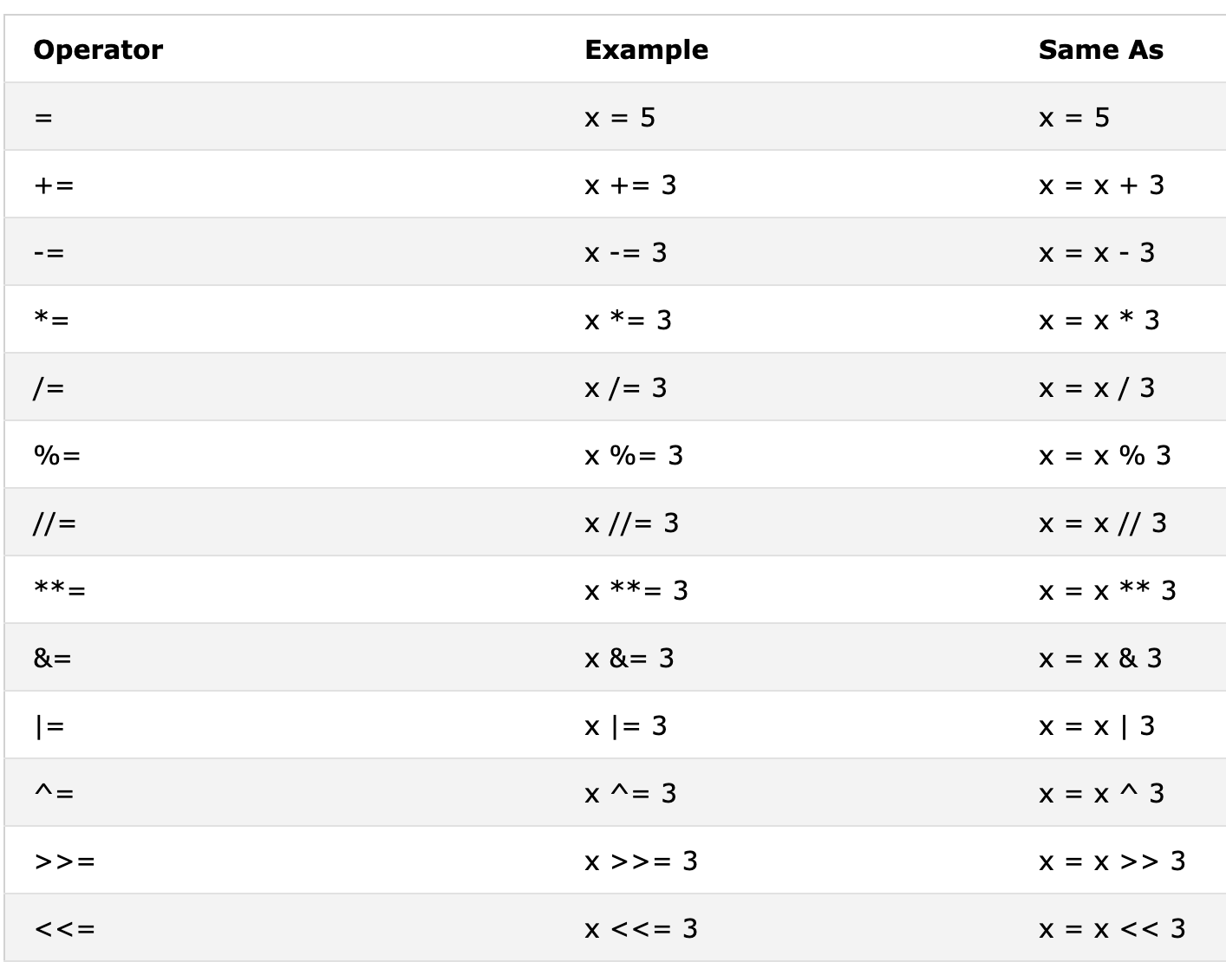
Assignment Operators
.

Slide 22
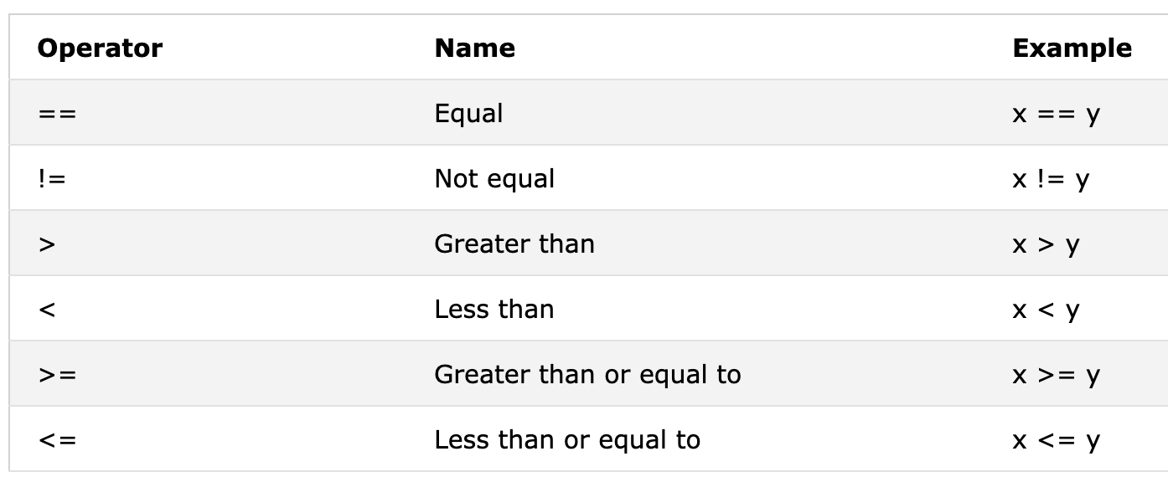
Comparison Operators
.

Slide 23
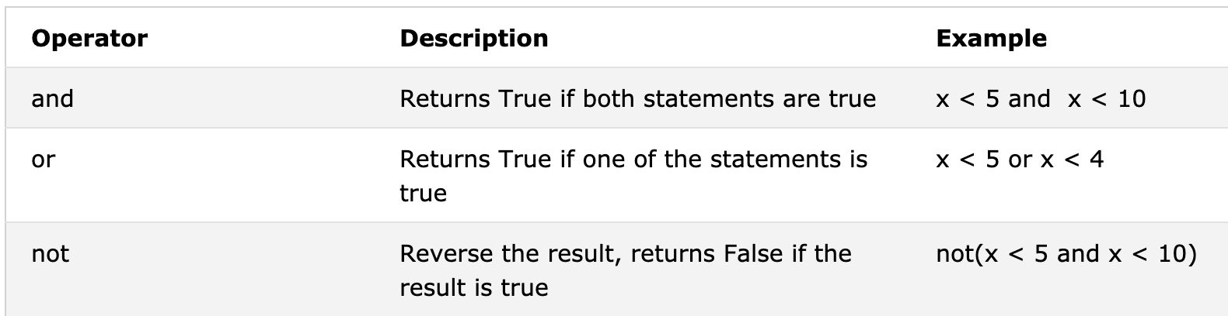
Logical Operators
.

Slide 24
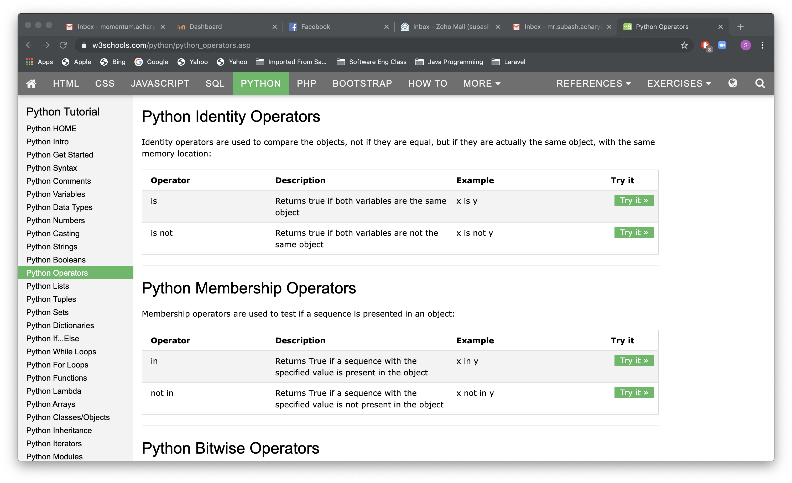
Identity Operators
.

Slide 25
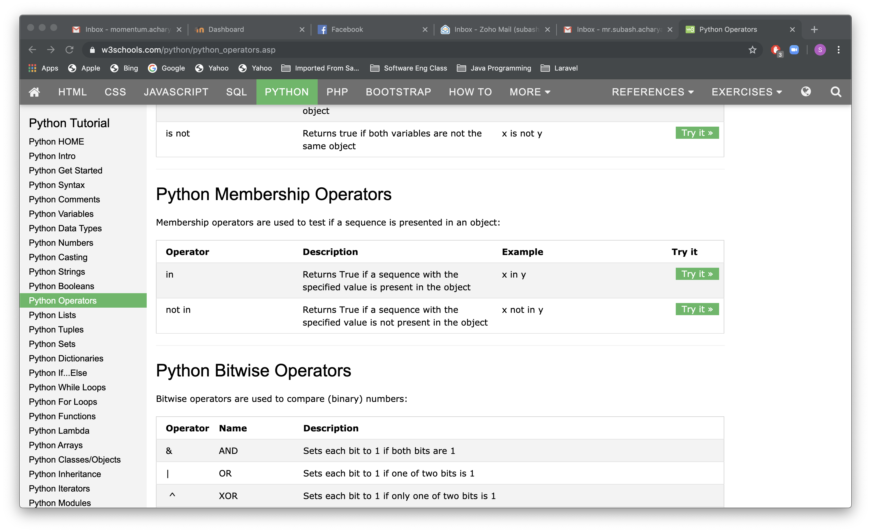
Membership Operators
.

Slide 26
Input from user
User input can be implemented using the input() function
name = input(“Enter your name: ”)
print(name) >>Enter your name: >>Enter your name: Subash
>>Subash
The default data type of the user input data is “str”, in order to perform math operations on that data, type conversion must be done
.

Slide 27
Errors
Syntax errors – Errors in the grammar of the language
english:
“cat dog boy” – not syntactically valid
“cat hugs boy” – syntactically valid
programming languages
“hi”5 –notsyntacticallyvalid
3.2*5 – syntactically valid
.

Slide 28
Errors
Common Python syntax errors include:
leaving out a keyword
putting a keyword in the wrong place
leaving out a symbol, such as a colon, comma or brackets
misspelling a keyword
incorrect indentation
empty block
.

Slide 29
Errors
Runtime errors – No syntax errors but program can’t complete execution in english:
“He are hungry” – syntactically valid but not meaningful
In programming languages :
3.2*5 – syntactically valid
3.2+”hi” – syntactically valid but the computer can’t really add 3.2 and “hi”
.

Slide 30
Errors
Some examples of Python runtime errors:
division by zero
performing an operation on incompatible types
using an identifier which has not been defined
accessing a list element, dictionary value or object attribute which doesn’t exist
trying to access a file which doesn’t exist
.

Slide 31
Errors
Logical errors – The program completes execution but delivers incorrect results english:
“Flying planes can be dangerous” – can have multiple meaning
programming languages: have only one meaning but may not be what the programmer intended
.

Slide 32
Errors
Some Logical Errors
using the wrong variable name
indenting a block to the wrong level
getting operator precedence wrong
making a mistake in a boolean expression
.

Slide 33
Compute Expression
A simple program to calculate the area of a circle,
𝐴 = 𝜋𝑟2 pi = 3.14 radius = 2 area = pi*(radius**2)
print(area)
>>>12.56
.

Slide 34
Thank you !
Any questions ?

